Slide 1
Adding reading list component to the course in Moodle
Library authority
2020-21

Slide 2
In most courses the component “Reading list” already exists If not, click “Turn editing on” Click “Add an activity or resource”
1
רשות הספריות

Slide 3
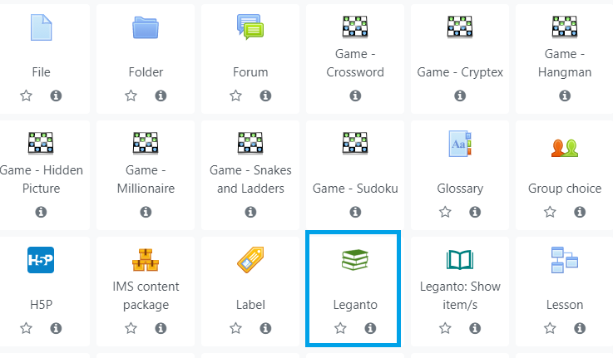
Choose the icon Leganto
רשות הספריות
2
רשות הספריות

Slide 4
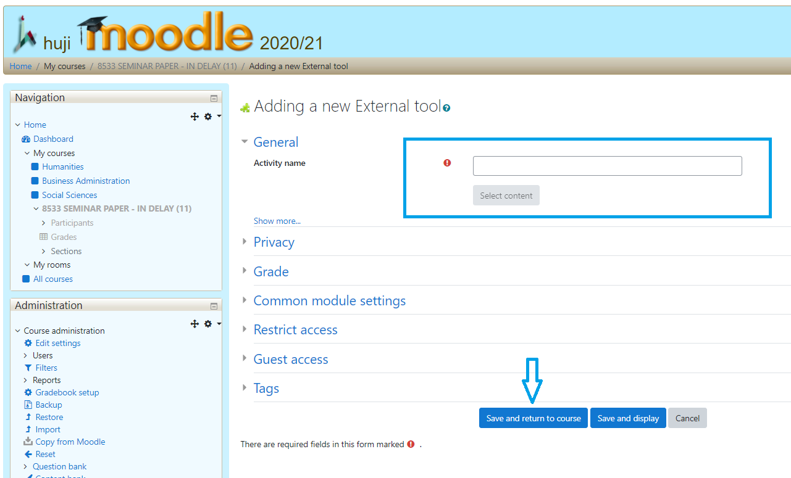
In the field “Activity name” enter the reading list name of your choice, and click “Save and return to course”
3
רשות הספריות

Slide 5
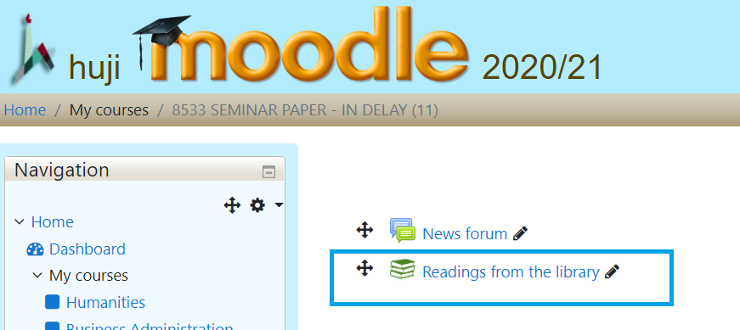
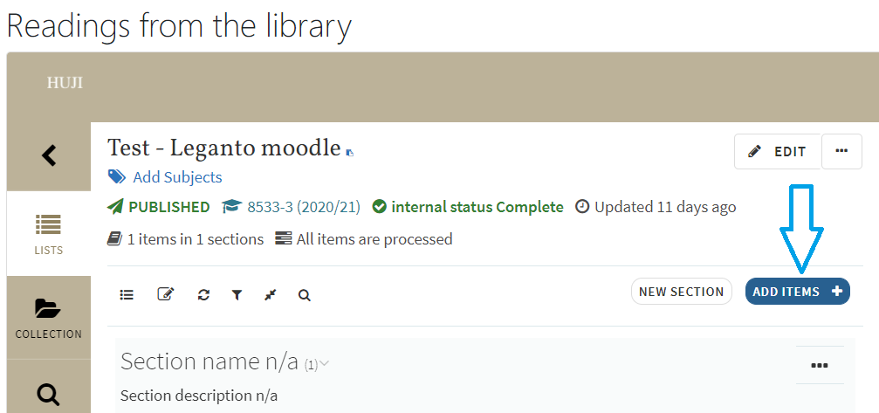
By clicking on the link, you can open the reading list and edit it
4
רשות הספריות

